Slide 1
Cavalier School of Poetry
Its originator is Ben Jonson.
The language is simple and clear. They reject the stereotyped expression of the sonnet. The poet doesn’t use fourteen lines.
The basic themes are love or carpe diem. Carpe Diem means seize the day, enjoy life while you’re young. In their love poems, there’s purely physical love. But it is not erotic.

Slide 2
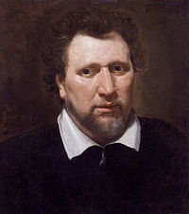
«Song : To Celia by Ben Jonson»
Students are expected to read the poem before the class meeting

Slide 3
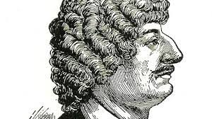
Robert Herrick’s «To the Virgins, To Make Much of Time»
The students are expected to read the poem and participate in class discussion.

